Slide 1


Scaling in the cloud

Slide 2
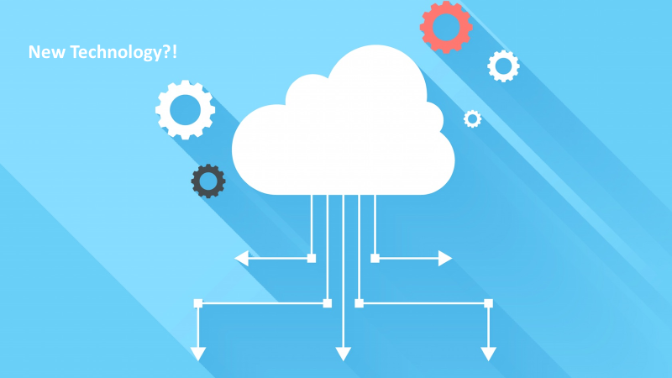

Slide 3


Slide 4


What we already know

Slide 5
More & more users

Slide 6

More & more users
Success!
Extra Load

Slide 7
One Solution
To reach out a website you should write something like that
www1.sth.com
www2.sth.com
.
.
.
wwwn.sth.com
What about if you got a bigger and get rid of these servers?

Slide 8
Another Solution
Load Balancer

Slide 9

Load Balancer
How to know that one server is out of service?
Heartbeat
But, What if the “Load Balancer” goes down?
Single Point Of Failer (SPOF)

Slide 10

Another Solution OMG !!
Load Balancers

Slide 11

So many concerns
Physical Place
Equipment
Implementation
Heat
Electricity
Access
Security
Scaling
So why don’t we move all of these implementation away and rent a server in the cloud?

Slide 12
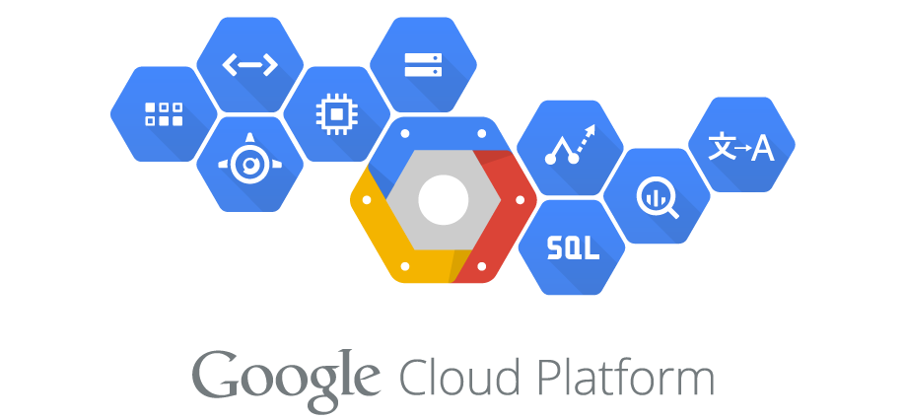

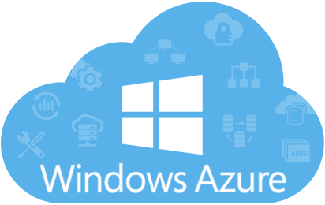
The ultimate solution... The Cloud

Slide 13
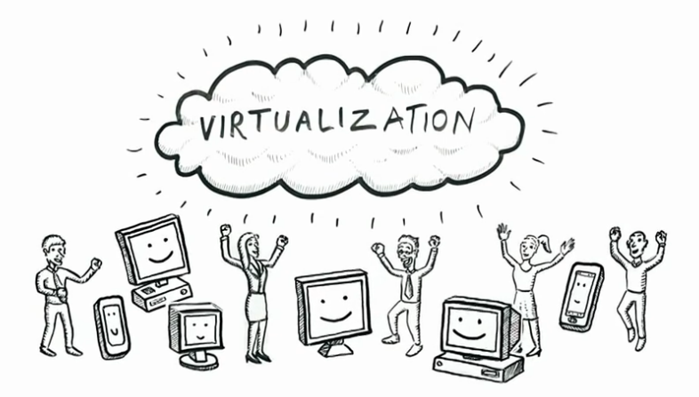
But How !!

Slide 14

Factors
Abstraction Level
Money
Control & Access

Slide 15
IAAS
Implement the architecture of our system and build the infrastructure virtually using software.
Auto scale the architecture due to the situation & the number of clients.

Slide 16
PAAS
Don’t care about the infrastructure. So, pay a little bit more to abstract away those kind of details.
Make it easier for you to run your application on the cloud.

Slide 17
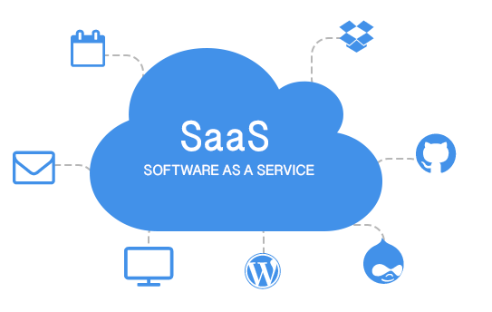
SAAS
All of underlying implementation details are abstracted away.

Slide 18
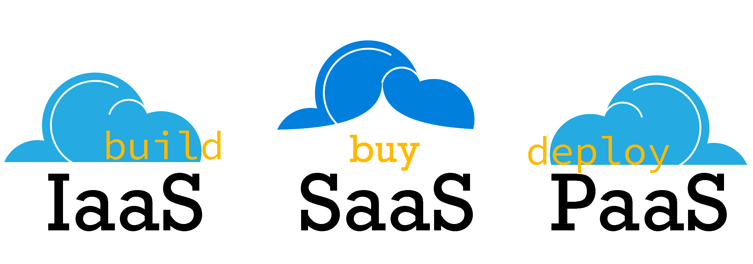
Those was cloud service models

Slide 19
Vertical Scaling
Increase the capacity of existing hardware or software by adding resources (RAM, CPU,Disks,..).
Vertical scaling is limited by the fact that you can only get as big as the size of the server.
No change to code.

Slide 20
Horizontal Scaling
Connect multiple hardware or software entities so that they work as a single logical unit.
Cannot be implemented at a moment’s notice.

Slide 21

Thank You For Listening

